Slide 1
SECURE DATA HIDING IN IMAGES USING STEGANOGRAPHY
PRESENTED BY:
Name: Siddhartha
College Name & Department: JNTUH(CNIS)

Slide 2
OUTLINE
Problem Statement
Technology used
Wow factor
End users
Result
Conclusion
Git-hub Link
Future scope

Slide 3
Problem Statement
Problem Statement: Secure Data Hiding in Images Using Steganography
In today's digital world, securing sensitive information is essential. This project focuses on using steganography to hide a secret message within an image using Python and OpenCV. The message is embedded into the least significant bits (LSB) of the image's pixels, making it invisible to the naked eye. A passcode is used to encrypt and decrypt the message, ensuring secure communication and preventing unauthorized access.

Slide 4
Technology used
Programming Language:
Python: The core programming language used to implement the steganography technique.
Libraries:
OpenCV: For reading and writing image files and manipulating pixel data.
OS: To interact with the operating system for tasks like opening the encrypted image file.
String: For handling text data during encryption and decryption processes.
Platform:
Windows
Development Environment:
Any Python IDE (e.g., PyCharm, Jupyter Notebook, VS Code) or terminal can be used for running and developing the project.
Concepts:
Steganography: The primary technique used to hide the message inside the image.
Encryption and Decryption: Used to secure and retrieve the hidden message based on the passcode provided.

Slide 5
Wow factors
Simple Passcode-Based Encryption
Pixel-Level Embedding
Minimal Library Usage
Customizable and Extendable
Platform-Specific Integration

Slide 6
End users
Cybersecurity Professionals
Government Agencies
Journalists and Whistleblowers
Researchers in Information Security
Individuals Concerned with Privacy

Slide 7
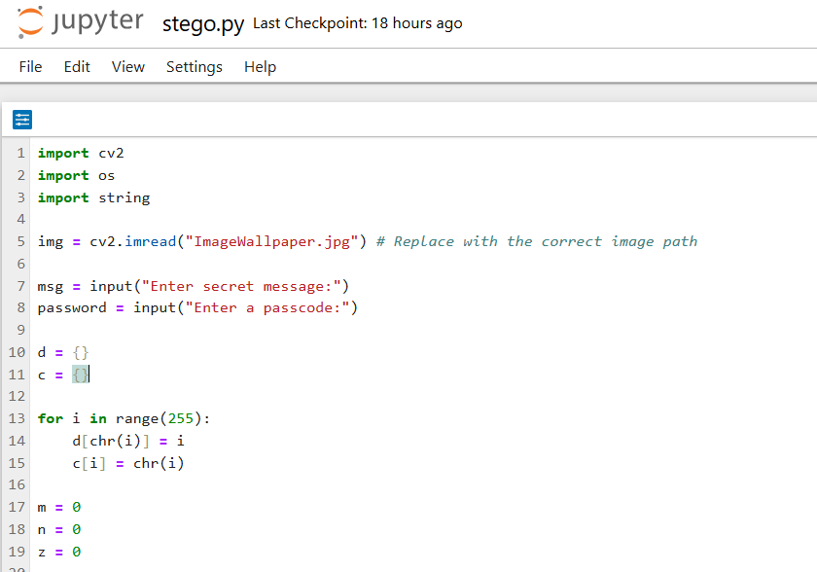


Results
Original Image
Encrypted Image

Slide 8
Conclusion
The project, Secure Data Hiding in Images Using Steganography, successfully addresses the challenge of securely transmitting sensitive information by embedding it within images. By utilizing the Least Significant Bit (LSB) method and incorporating a passcode-based encryption system, this project ensures that the hidden data remains undetectable to unauthorized users while being easily retrievable by the intended recipient. The simple yet effective approach makes it adaptable for various real-world applications, ranging from secure communication in government agencies to privacy-conscious individuals.

Slide 9
GitHub Link
https://github.com/SiddharthaVakiti/Secure-Data-Hiding-in-Images-Using-Steganography.git

Slide 10
Future scope
Enhanced Encryption
Multi-File Embedding.
Cross-Platform Compatibility.
Robustness Against Image Manipulation
User-Friendly Interface.

Slide 11
THANK YOU

